Slide 1
Overview of ground-based part of the PsA research project and PWING
PsA research project and PWING project

Slide 2
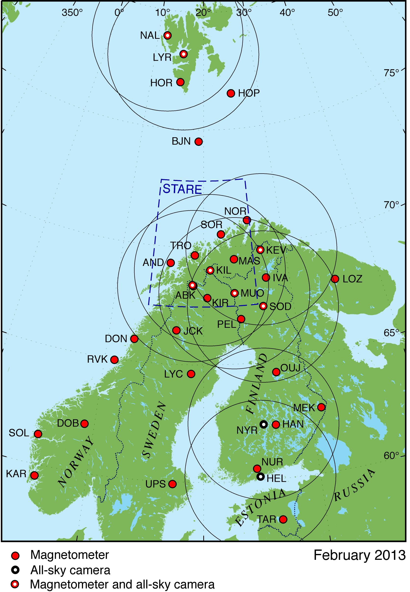
Phase 4 8 EMCCD ASIs of PsA + PWING
Tromsø: 100 Hz EMCCD ASI - BG3 (inoperative now) Monochromatic ASI（10 Hz） x 2 （427.8 nm + 844.6 nm）→ currently 20 Hz 20 Hz Fluxgate magnetometer 5 channel photometer
Sodankyla: 100 Hz EMCCD ASI – BG3 Many supporting instruments of SGO
Tjautjas: 100 Hz EMCCD ASI – BG3
Kevo: 100 Hz EMCCD ASI – BG3（PWING）
Gakona in Alaska: 100 Hz EMCCD ASI – BG3（PWING）
Poker Flat in Alaska: 100 Hz EMCCD ASI – BG3（PWING）
← Alaska (Gakona, Poker Flat)
Kevo
Tromsø
MLAT 65
Tjautjas
Sodankyla
MLAT 60

Slide 3
A few things about the data
Quick Look data browser: https://ergsc.isee.nagoya-u.ac.jp/psa-gnd/bin/psa.cgi
Digital data in raw format: https://ergsc.isee.nagoya-u.ac.jp/psa-gnd/pub/raw/ Password is required for access IDL code for reading/plotting the data is provided
Conjunction Interval Finder (CIF): https://ergsc.isee.nagoya-u.ac.jp/psa-gnd/bin/cif.cgi

Slide 4
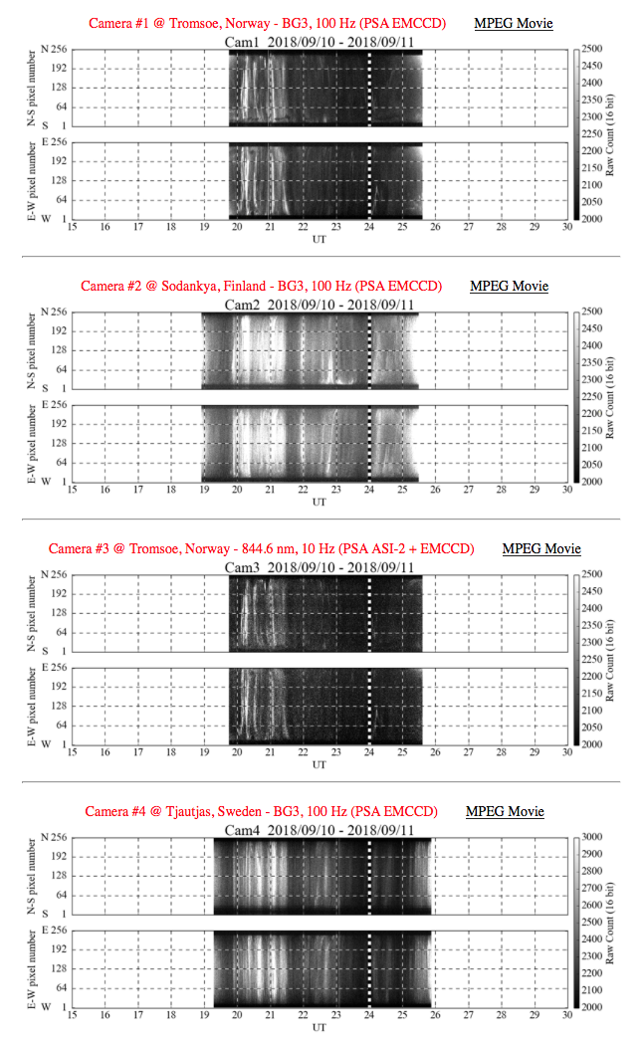
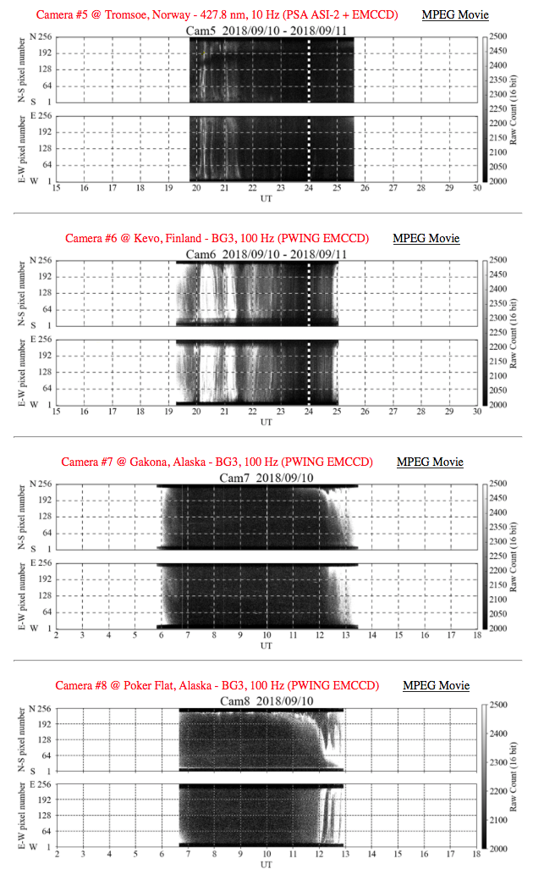
https://ergsc.isee.nagoya-u.ac.jp/psa-gnd/bin/psa.cgi
Quick Look Data Browser
Tromsø
100 Hz
Tromsø
427.8 nm
Sodankyla
100 Hz
Kevo
100 Hz
Tromsø
844.6 nm
Gakona
100 Hz
Tjautjas
100 Hz
Poker Flat
100 Hz

Slide 5
https://ergsc.isee.nagoya-u.ac.jp/psa-gnd/bin/cif.cgi
Conjunction Interval Finder
New!

Slide 6
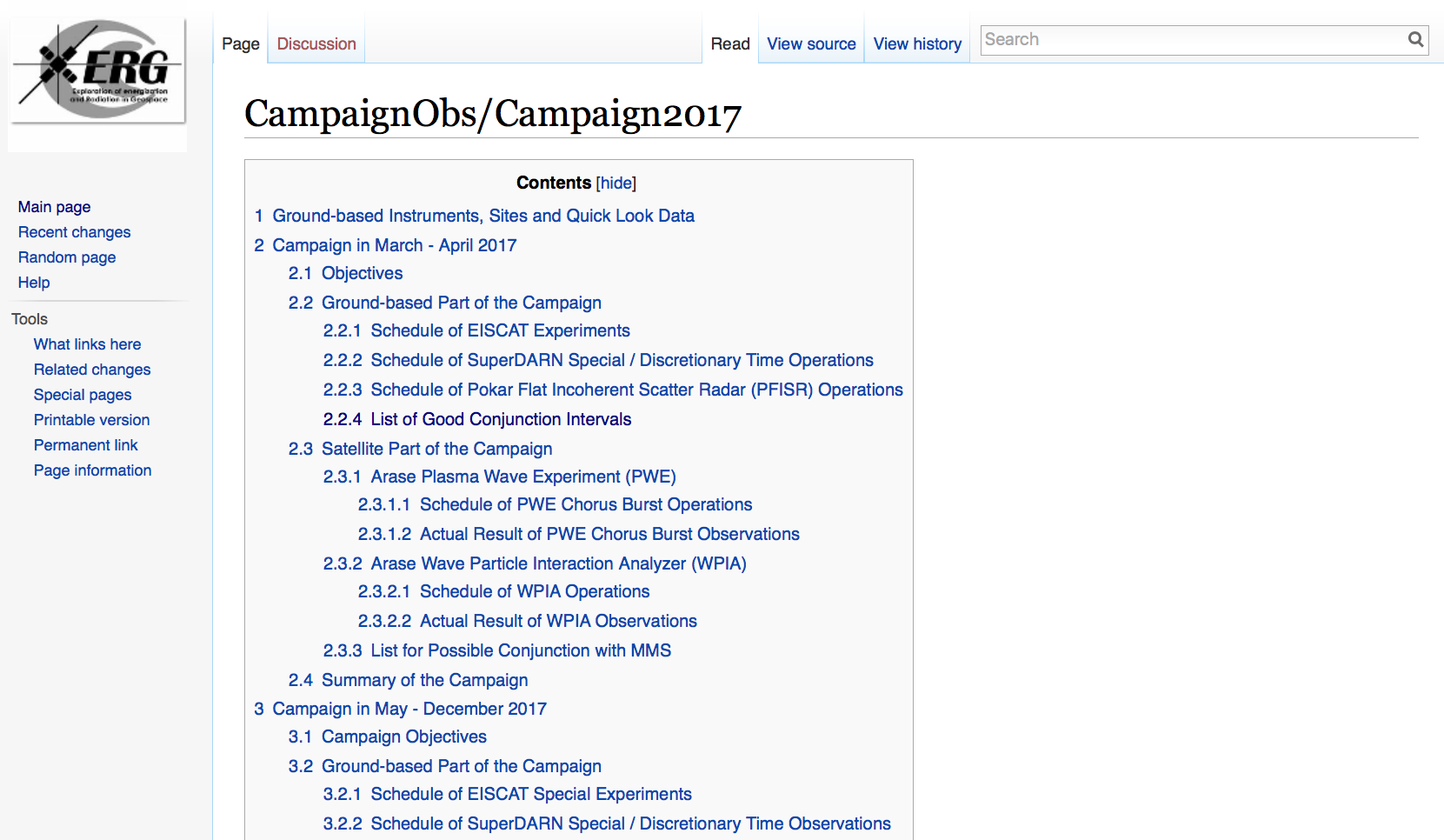
https://ergsc.isee.nagoya-u.ac.jp/mw/index.php/CampaignObs/Campaign2017
List of Good
Conjunctions

Slide 7
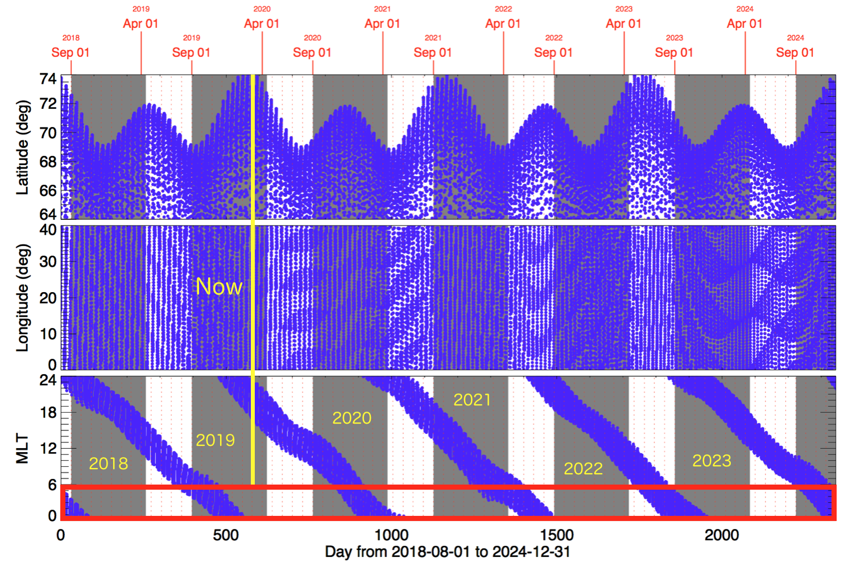
Long-term prediction of conjunction

Slide 8
Rocket experiment in Dec 2020
NASA Rocket launch is scheduled in Dec 2020 Launch site: Poker Flat, Alaska Launch window: Mid December
An EMCCD camera and an sCMOS camera are planned to be installed in the down-range of rocket trajectory from the Japanese team
High-energy electron detector, auroral cameras and magnetometer will be on-board by the effort of Japanese team

