Slide 1
Examples of simultaneous observations : PsA and MeV electron microbursts

Slide 2
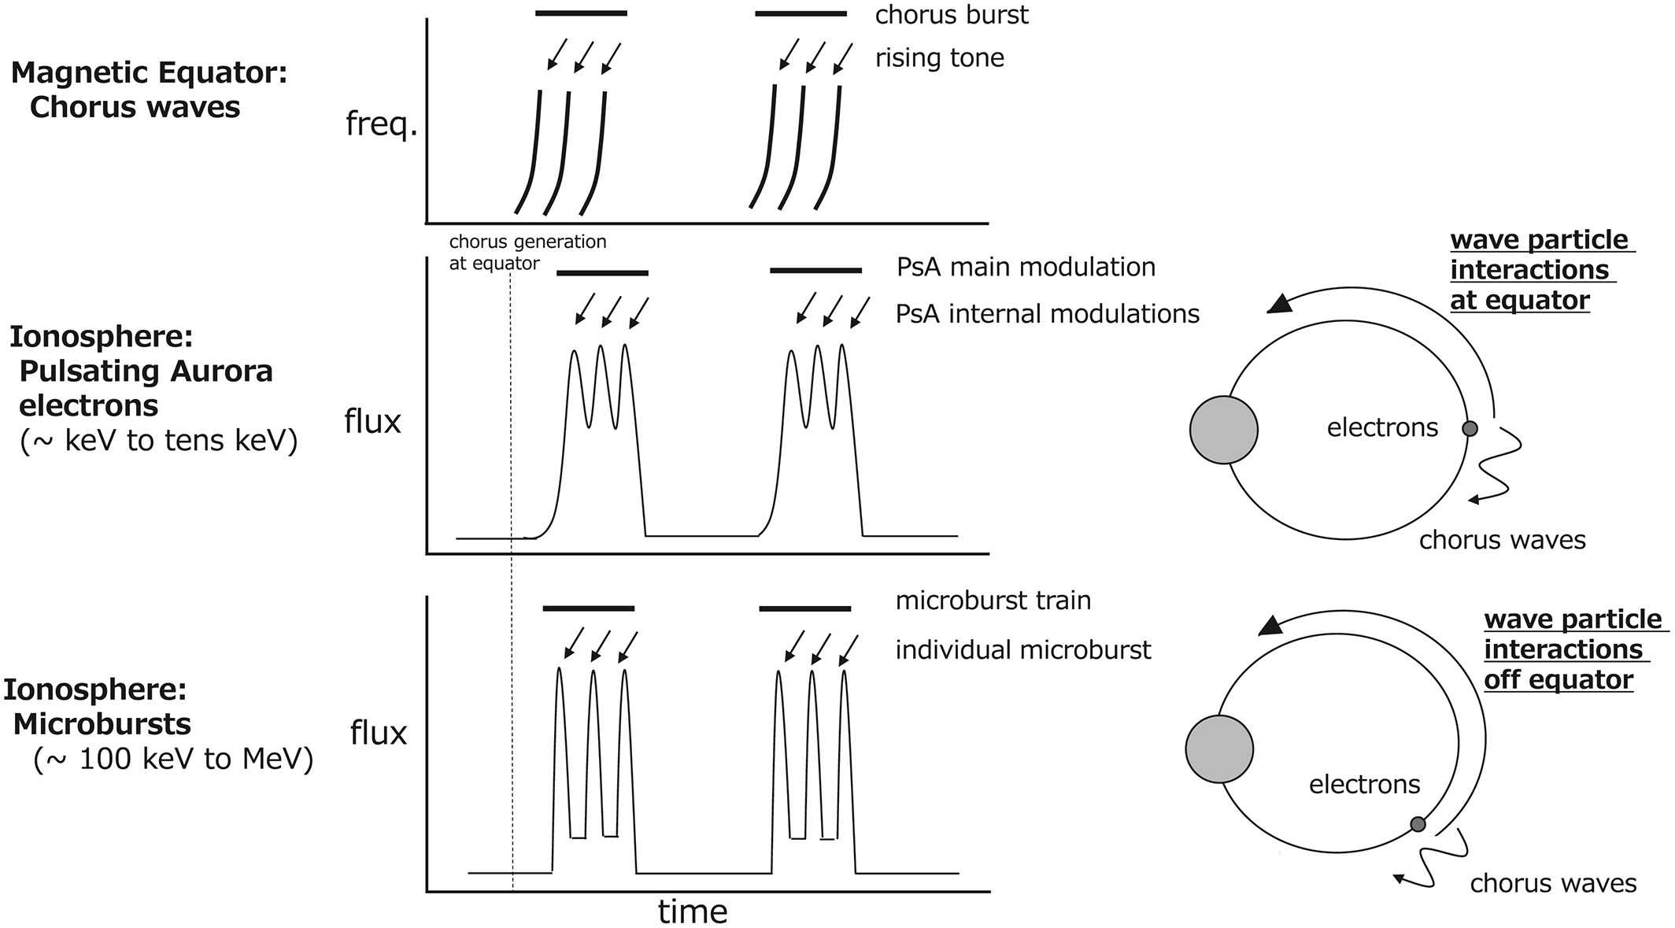
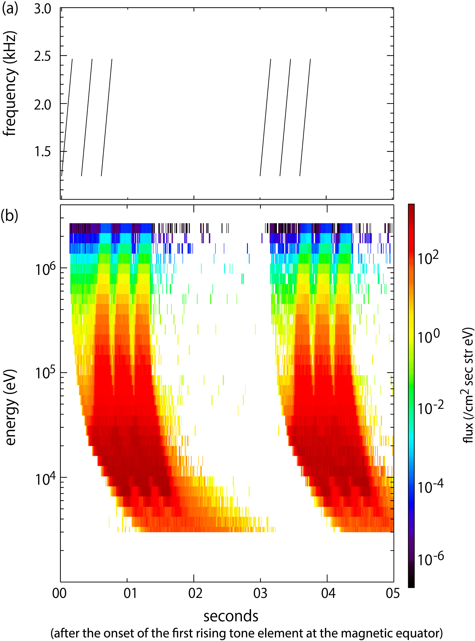
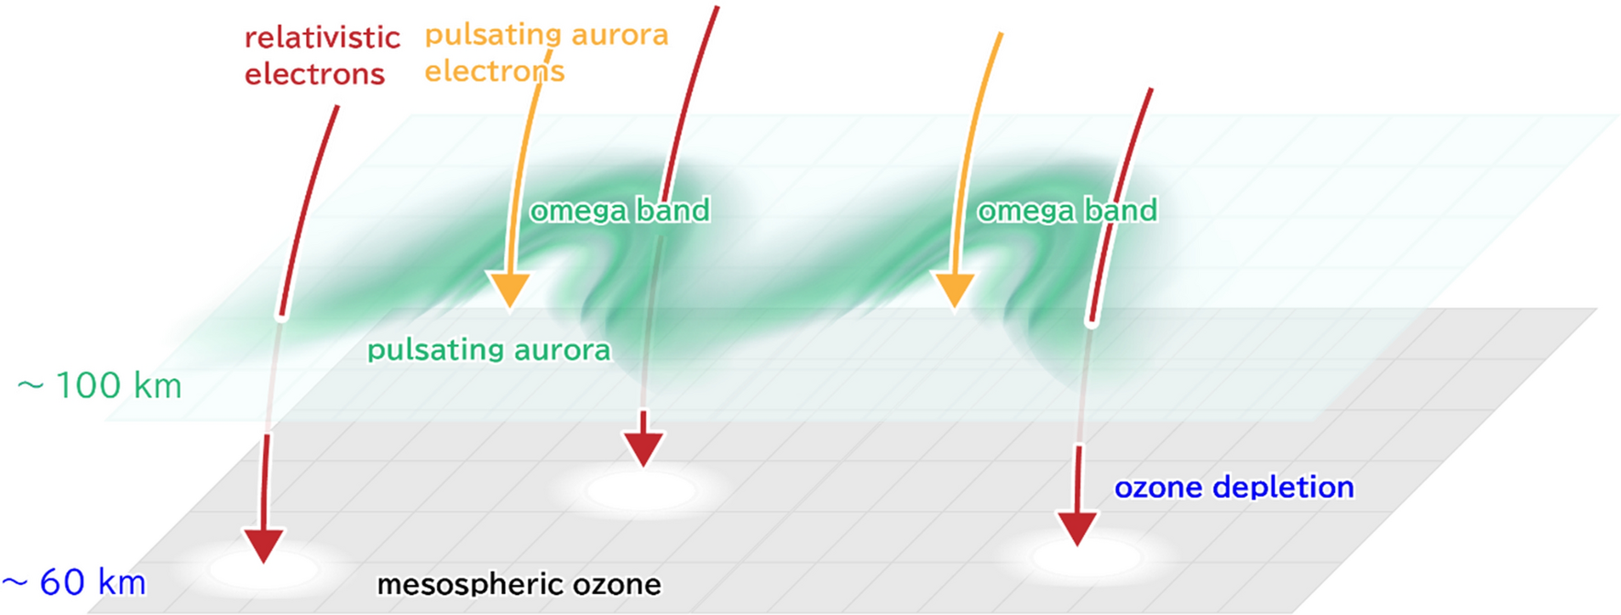
Model of simultaneous precipitations of PsA and relativistic microbursts
chorus
PsA electrons
MeV electron
microbursts
High-latitude propagation of chorus waves is important
to cause energetic electron precipitations.
Miyoshi+[2020]

Slide 3
Global Picture of PsA: MLT dependence
Global Image from ISS
Blue/Green Ratio of PsA
High-energy
Low-energy
B/G ratio of PsA increases in the morning sector, i.e., hard electrons can be observed
in the morning sector.
Nanjo+[2020]

Slide 4
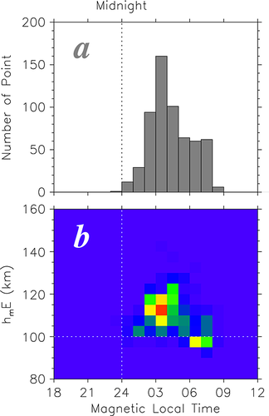
MLT dependence
EISCAT measurements : ionization altitude of PsA
Hosokawa and Ogawa[2015]
Ionization altitudes during PsA becomes lower at the morning side.

Slide 5
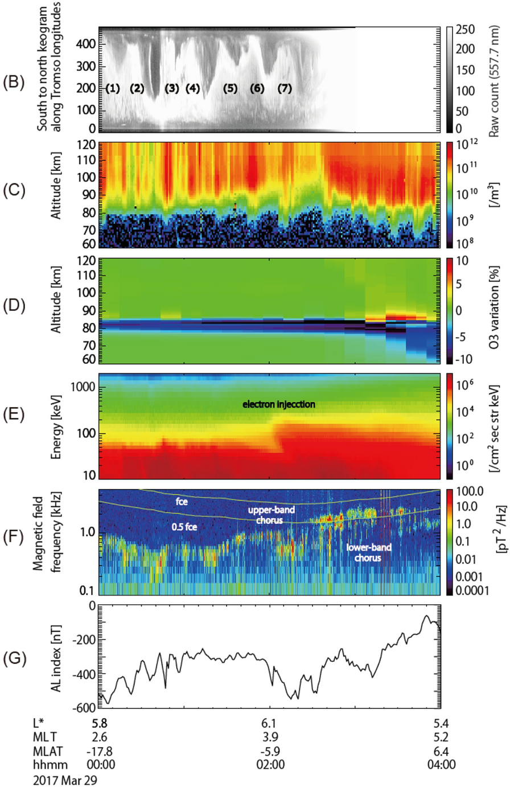
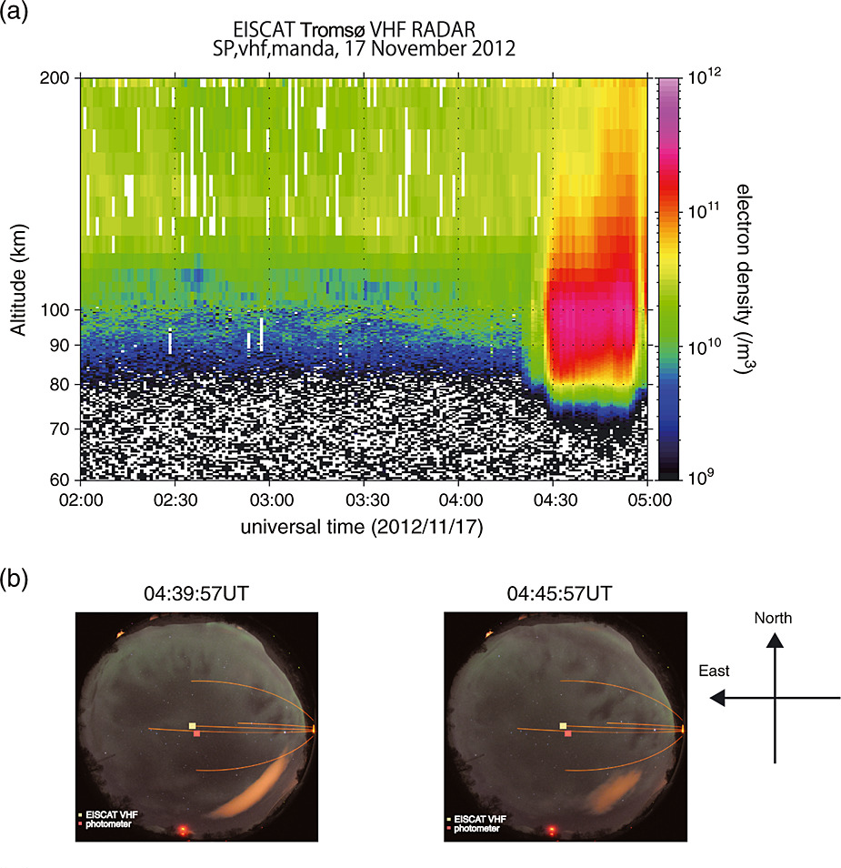
EISCAT measurements at the morning side
MLT=02:00
MLT=04:00
EISCAT measurements : MeV electron precipitations
MLT=05:00
Miyoshi+[2015a]
Miyoshi+[2021]
Ionization altitude at 68 km - 60 km indicates that sub-MeV / MeV electrons associated with PsA in the morning side.

Slide 6
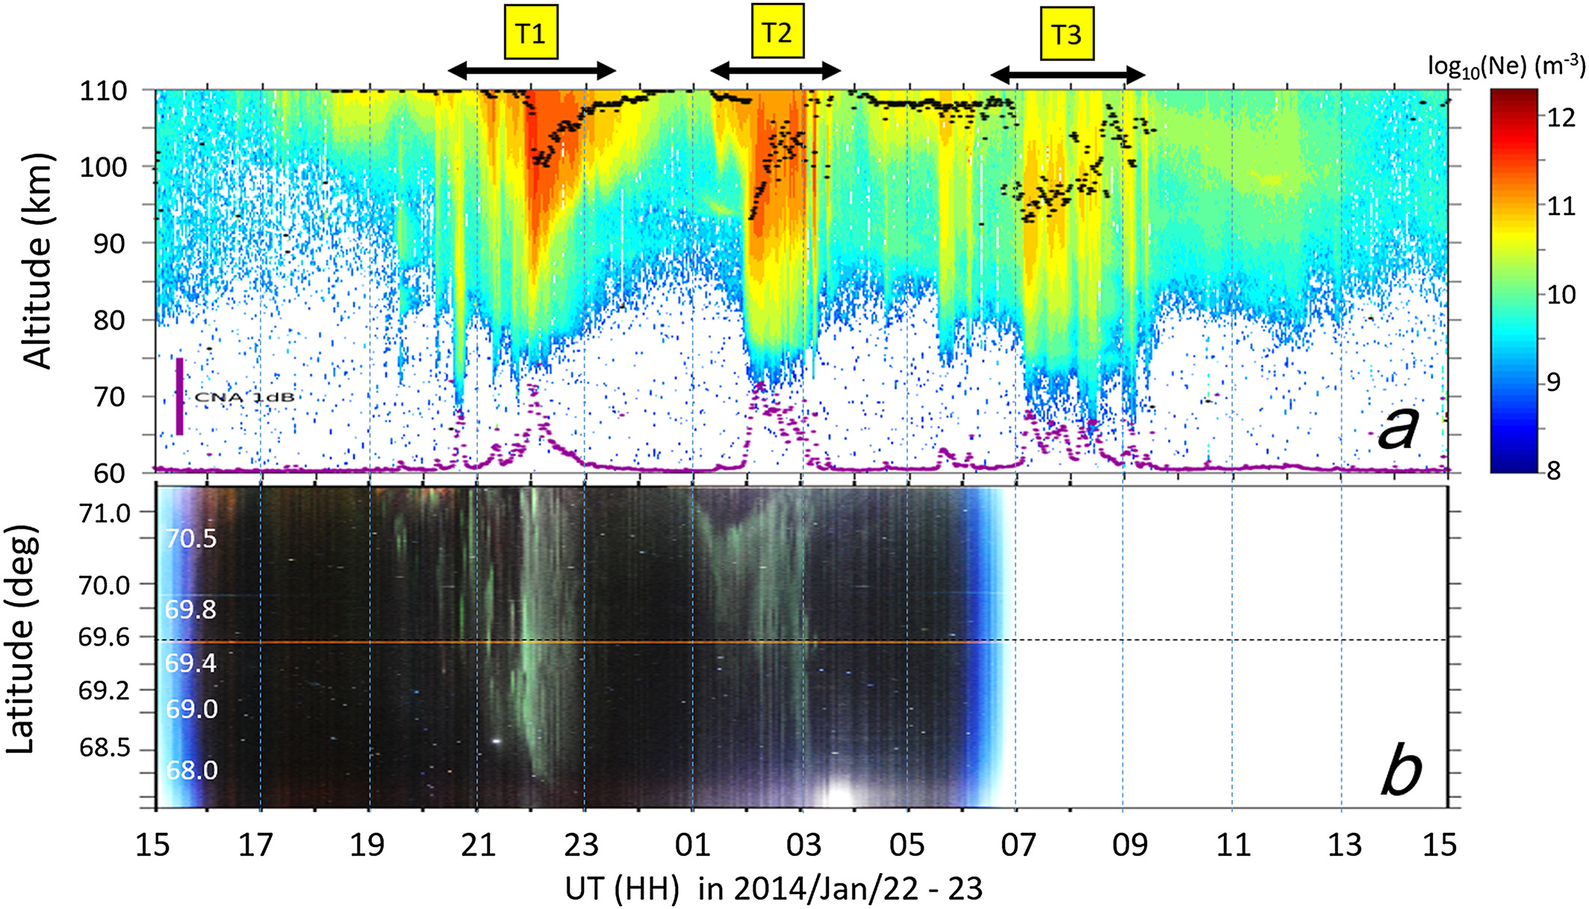
EISCAT measurements at the morning side
EISCAT/Riometer(KAIRA) measurements
MLT=02:00
MLT=06:00
Oyama+[2017]
The energy of the precipitating electrons depends on the MLT, with increase in flux
for energies > 200 keV with MLT. These higher energy EEPs were found to be coincident with the formation of patchy structure.

Slide 7
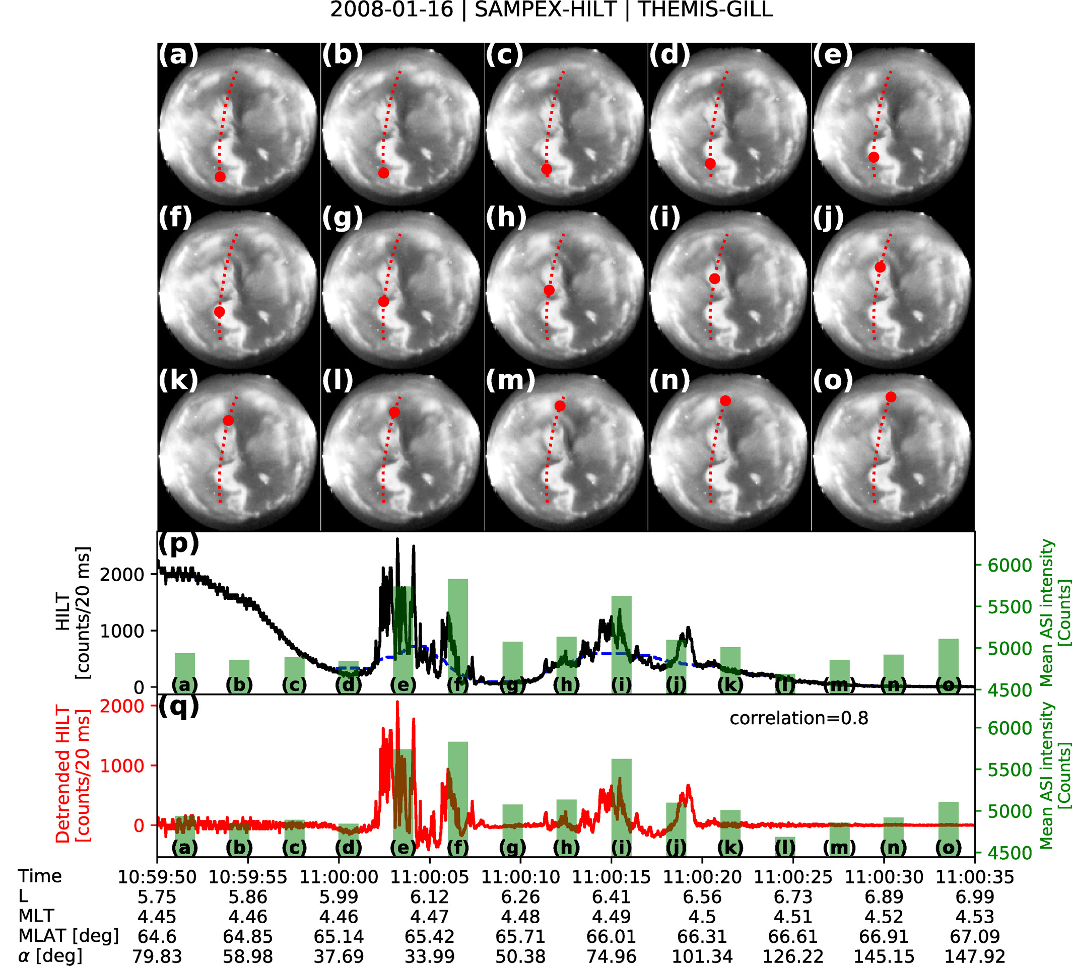
Simultaneous measurements
THEMIS/GBO and SAMPEX (MLT = 4.5)
- Simultaneous precipitations of PsA electrons and relativistic
electron microbursts.
Shumko+[2021]

Slide 8
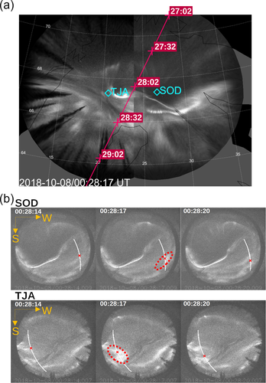
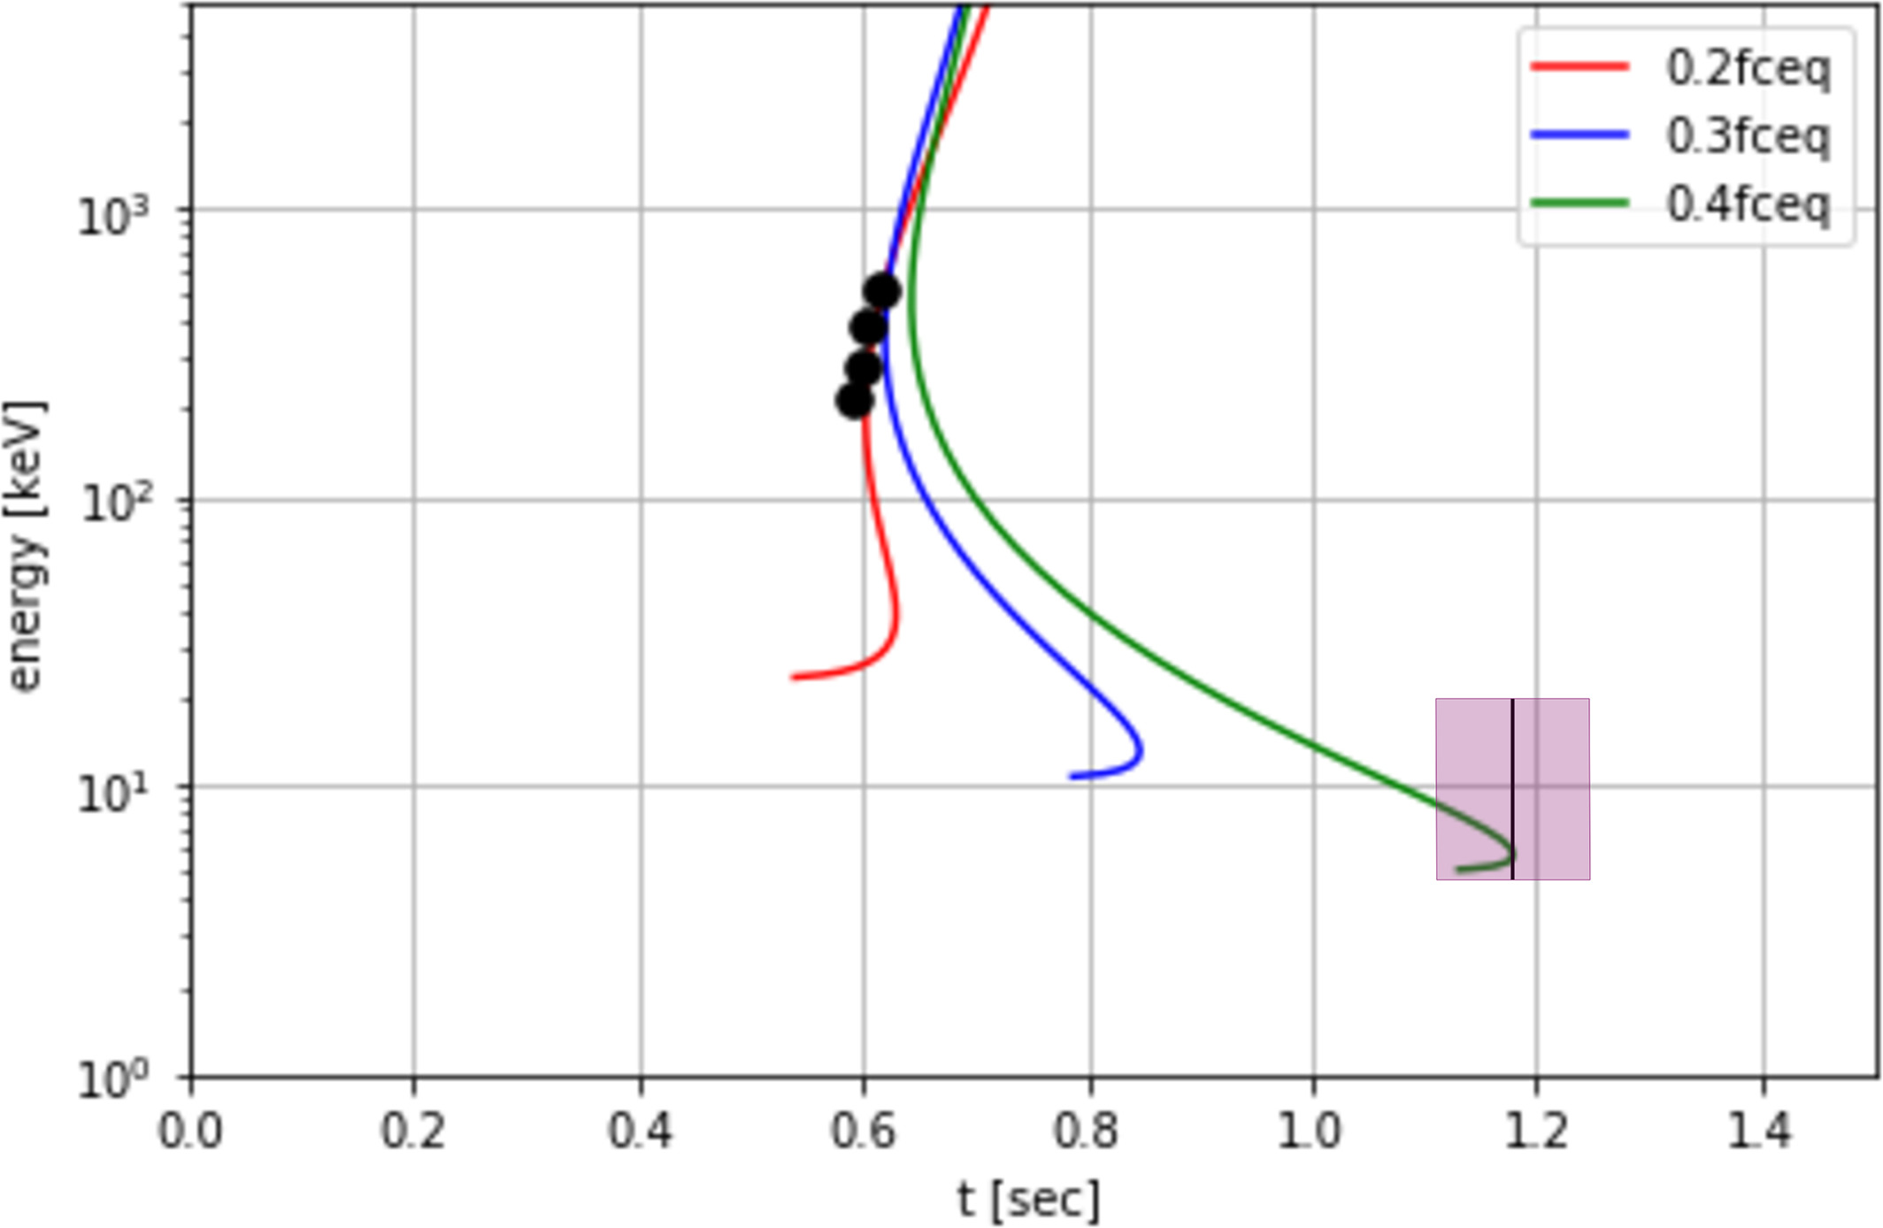
Simultaneous measurements
EMCCD observations and Firebird (MLT=3.4)
Theoretical energy dispersion
Sub MeV electron
(Firebird)
PsA
(EMCCD at Ground)
- Simultaneous precipitations of PsA electrons and relativistic
electron microbursts.
- Inverse dispersion is detected, as predicted by the theory.
Kawamura+[2021]

Slide 9
Draft: Possible Launch Conditions
[Following three conditions should be satisfied]
・Geomagnetic Conditions:
substorm recovery phase
20-30 min after aurora breakup
・PsA:
detection of main pulsations
internal modulations are detected above Venetie
・PFISR:
low-altitudes ionization of PFISR
[Additional Conditions]
・PsA:
Patchy type
・ MLT:
post-midnight (LTs for possible AIC measurements)
・Riometer:
significant absorption of CNA
・VLF at Gakona
supports: activity of VLF at Gakona (real time monitoring is possible?)

Slide 10
Effect of solar illumination
http://gwave.cei.uec.ac.jp/~hosokawa/public/lamp/
Three cases:
Feb 24, 2022 →→→→
Mar 03, 2022
Mar 10, 2022

Slide 11
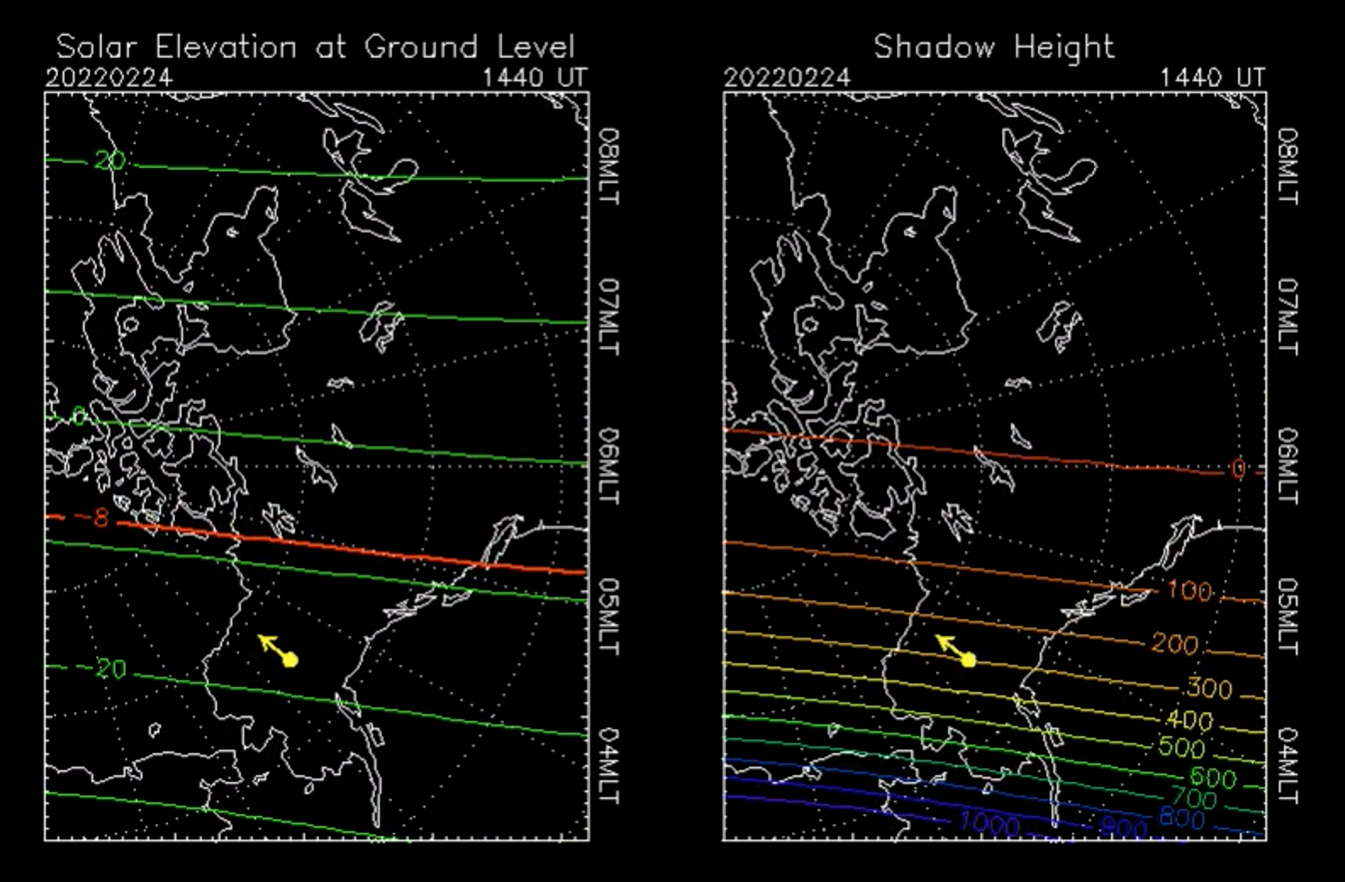
Effect of solar illumination: Feb 24

Slide 12
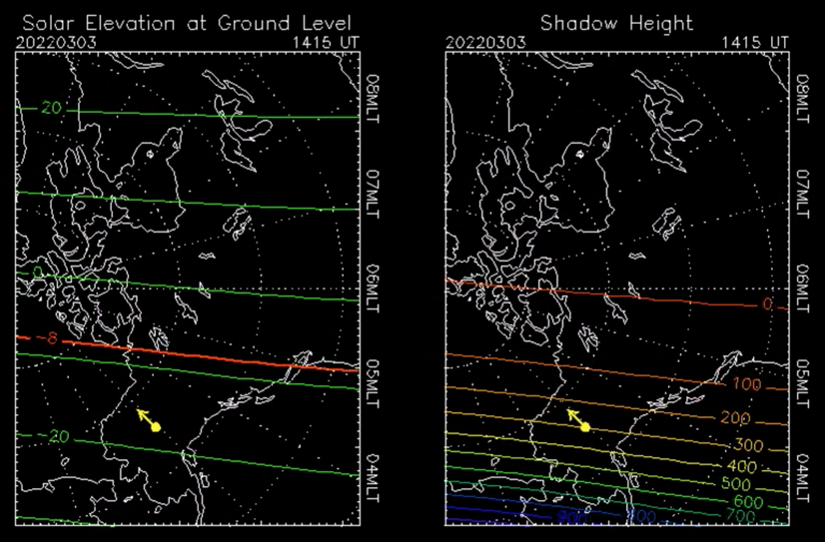
Effect of solar illumination: Mar 3

Slide 13
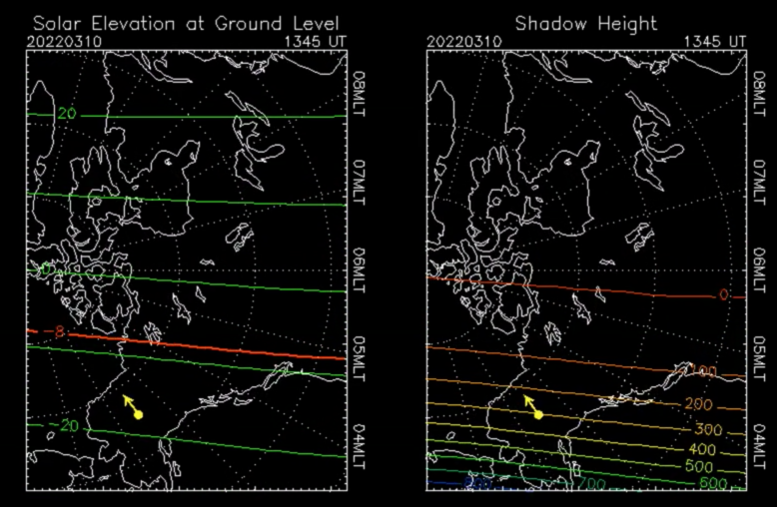
Effect of solar illumination: Mar 10

Slide 14
Effect of solar illumination
# LT = UT - 8 h
Feb 24
300 km shadow height: 1440 UT (0640 LT) ~ 3.5 MLT
Mar 3
300 km shadow height: 1415 UT (0615 LT) ~ 3.0 MLT
Mar 10
300 km shadow height: 1345 UT (0545 LT) ~ 2.5 MLT

