Slide 1
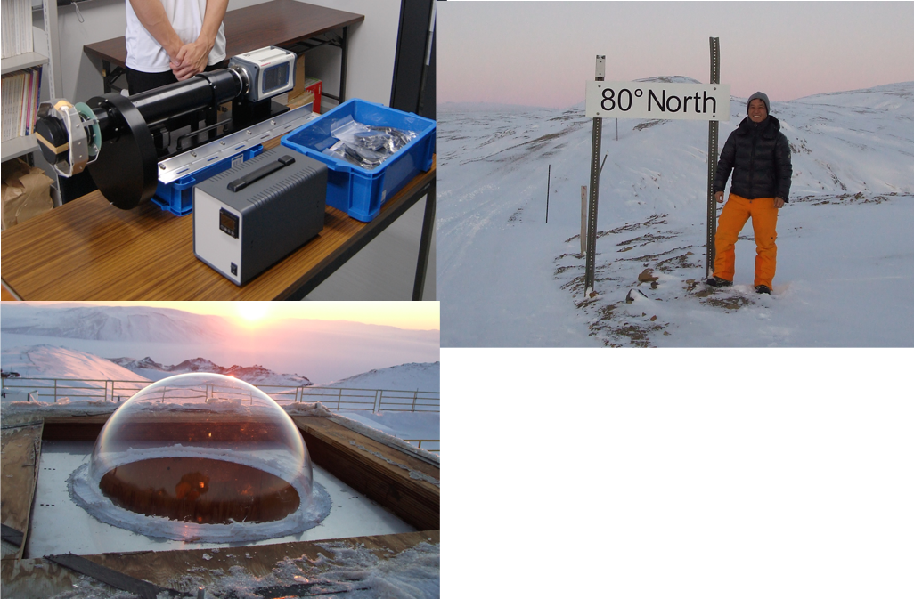
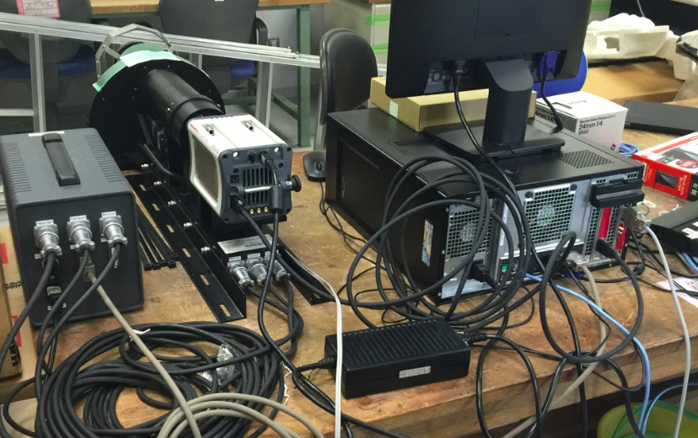
All-sky Airglow Imager (ASI)
as part of Optical Mesosphere Theremosphere Imagers (OMTIs)

Slide 2
All-sky Airglow Imager (ASI)
as part of Optical Mesosphere Theremosphere Imagers (OMTIs)
Measures 3 airglow lines or bands:
630.0 nm oxygen emission – OI 630.0 nm:
electron density at ~300 km altitudes, 1 min temporal resolution
557.7 nm oxygen emission – OI 557.7 nm:
greenish aurora, and gravity waves near mesopause
OH band:
gravity waves near mesopause
OH Band

Slide 3
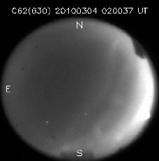
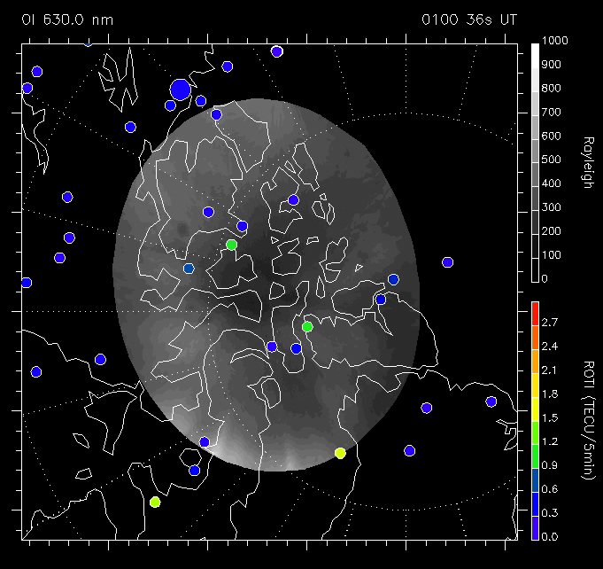
All-sky Airglow Imager (ASI)
as part of Optical Mesosphere Theremosphere Imagers (OMTIs)
Primary scientific target is “polar cap patches”
- regions of high electron density at 300 km altitude
- potential risk to affect the GNSS systems at high-latitudes

